Slide 1

Notes:
Core Topic: Introduction to The Ulti4mate Vibe Coding Playbook
Good morning, everyone, and welcome. Today, we are diving into one of the most exciting shifts in software creation: The Ultimate Vibe Coding Playbook.
If you look at the subtitle on this slide, it sets a bold premise: How to build, secure, and monetize a full-stack SaaS with zero technical background. For decades, building software required years of computer science education, complex syntax memorization, and exhausting debugging sessions.
Today, we are entering the era of Vibe Coding—where natural language direction replaces manual coding, and AI agents act as your engineering team. Throughout this session, we will break down the complete playbook—from planning and UI generation to automated security, database management, and live deployment. Let's get started.
The Ultimate Vibe Coding Tutorial for Beginners
https://www.youtube.com/watch?v=XLhdE-qV87E

Slide 2
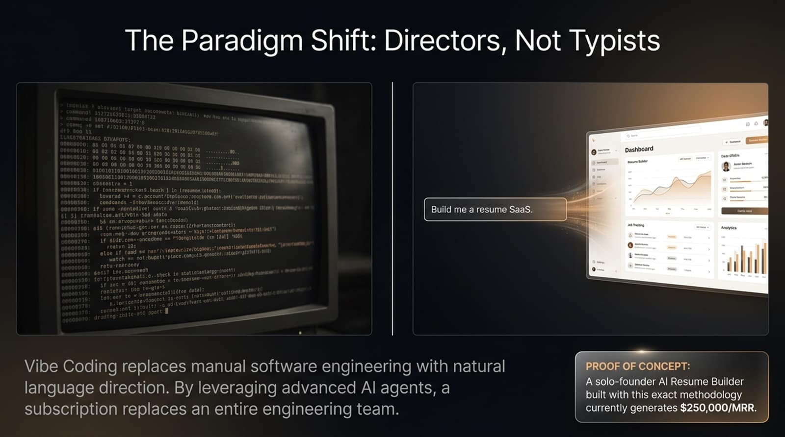
Notes:
Core Topic: Natural Language Direction vs. Traditional Coding and Real-World SaaS Proof
To understand vibe coding, we must first recognize the fundamental paradigm shift illustrated on this slide.
On the left, we see the legacy world of software engineering: staring at raw terminal windows, typing complex syntax line by line, and managing arcane build scripts. On the right, we see the new world: prompting an AI agent with natural language—‘Build me a resume SaaS’—and watching a fully functional, beautiful dashboard materialize instantly.
Proof of Concept: This isn't just theory. As noted in the callout box, a solo-founder AI resume builder built using this exact methodology currently generates $250,000 per month in recurring revenue. You no longer need a 20-person engineering team to launch a profitable software company.

Slide 3
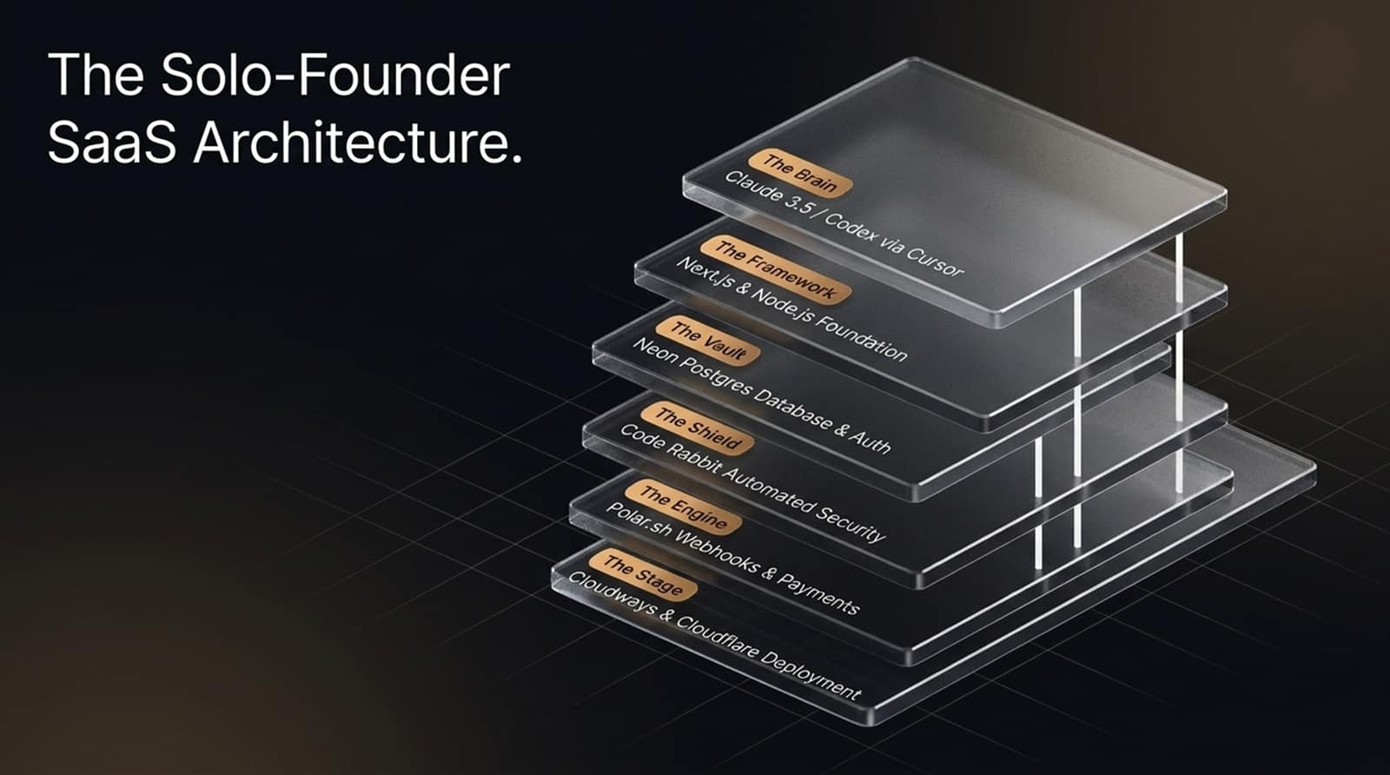
Notes:
Core Topic: The Six Layers of Modern AI Stack
What does the modern solo-founder stack actually look like? Let's examine the six-layer architecture stacked out on this slide:
The Brain: Claude 3.5 Sonnet / Codex via Cursor or VS Code providing the intelligence.
The Framework: Next.js and Node.js serving as the robust application foundation.
The Vault: Neon Postgres Database & Auth handling user data and identity securely.
The Shield: CodeRabbit providing automated AI security code reviews.
The Engine: Polar.sh webhooks and payment processing handling transactions.
The Stage: Cloudways and Cloudflare managing lightning-fast global deployment and custom domains.
Each layer is managed by specialized AI tools, allowing a single non-technical founder to operate a complete enterprise stack.

Slide 4
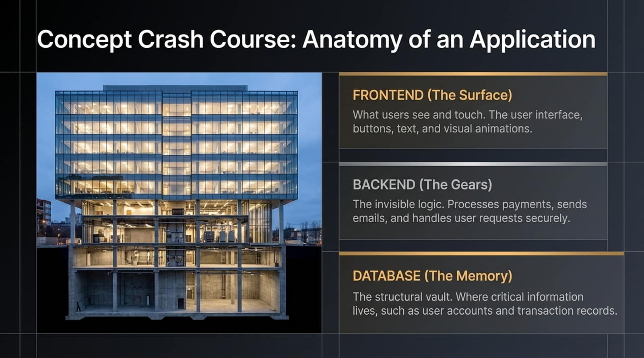
Notes:
Core Topic: Understanding Frontend, Backend, and Database Layers
Before we start prompting AI, we need to understand the basic anatomy of an application, just like looking at the cross-section of a building:
Frontend (The Surface): What users see and touch. The user interface, buttons, text, color schemes, and visual animations.
Backend (The Gears): The invisible logic. It processes payments, sends verification emails, and handles user requests securely behind the scenes.
Database (The Memory): The structural vault. Where critical information lives permanently, such as user accounts, subscription tiers, and transaction records.
Knowing these three components ensures you can direct your AI agent precisely when something needs fixing.

Slide 5
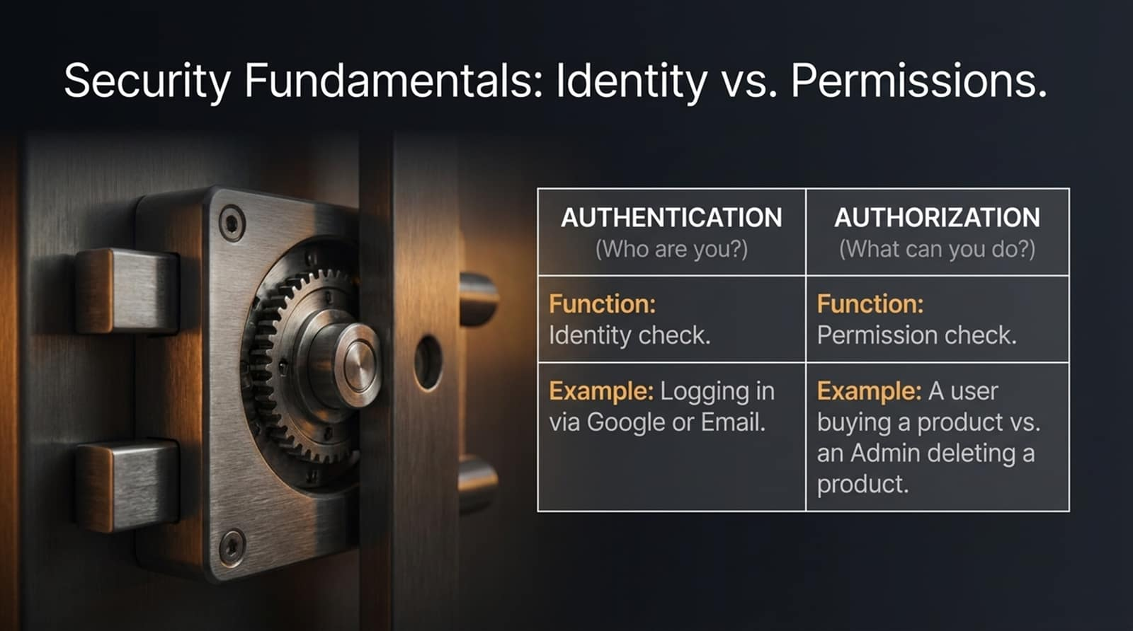
Notes:
Core Topic: Authentication vs. Authorization
Security is paramount when building monetized software. We must distinguish between two core concepts:
Authentication (Who are you?): The identity check. When a user logs in via Google, Apple, or email, authentication verifies their identity.
Authorization (What can you do?): The permission check. Once logged in, authorization determines whether a user is allowed to access a paid feature or if an Admin has rights to delete a database record.
Conflating these two is the #1 cause of security vulnerabilities in beginner-built applications. Always instruct your AI agent to enforce strict authorization checks on every backend route.

Slide 6
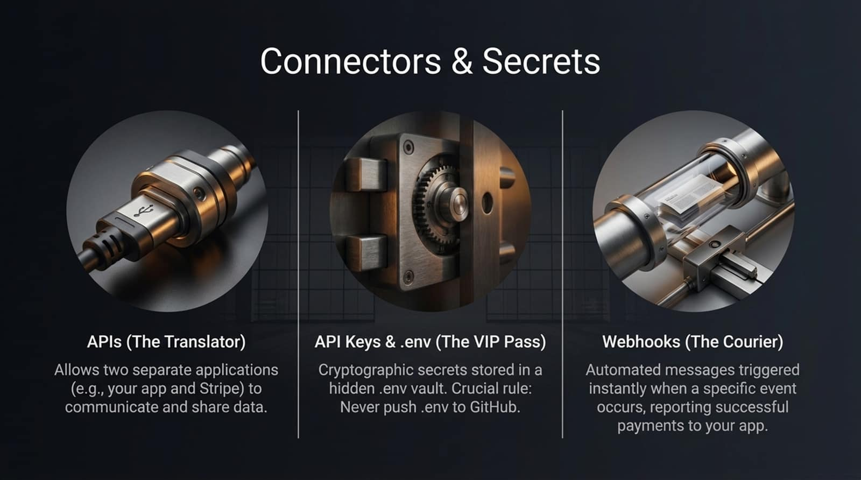
Notes:
Core Topic: APIs, Environment Variables, and Webhooks
Applications don't live in a vacuum; they talk to external services using specific connectors:
APIs (The Translator): Allow two separate applications—like your app and Stripe or Polar—to communicate and share data seamlessly.
API Keys & .env (The VIP Pass): Cryptographic secrets stored in a hidden .env vault. Crucial Rule: Never push your .env file to GitHub, or your database and payment keys will be exposed to the public.
Webhooks (The Courier): Automated messages triggered instantly when a specific event occurs—such as notifying your app the exact second a customer's payment clears.

Slide 7
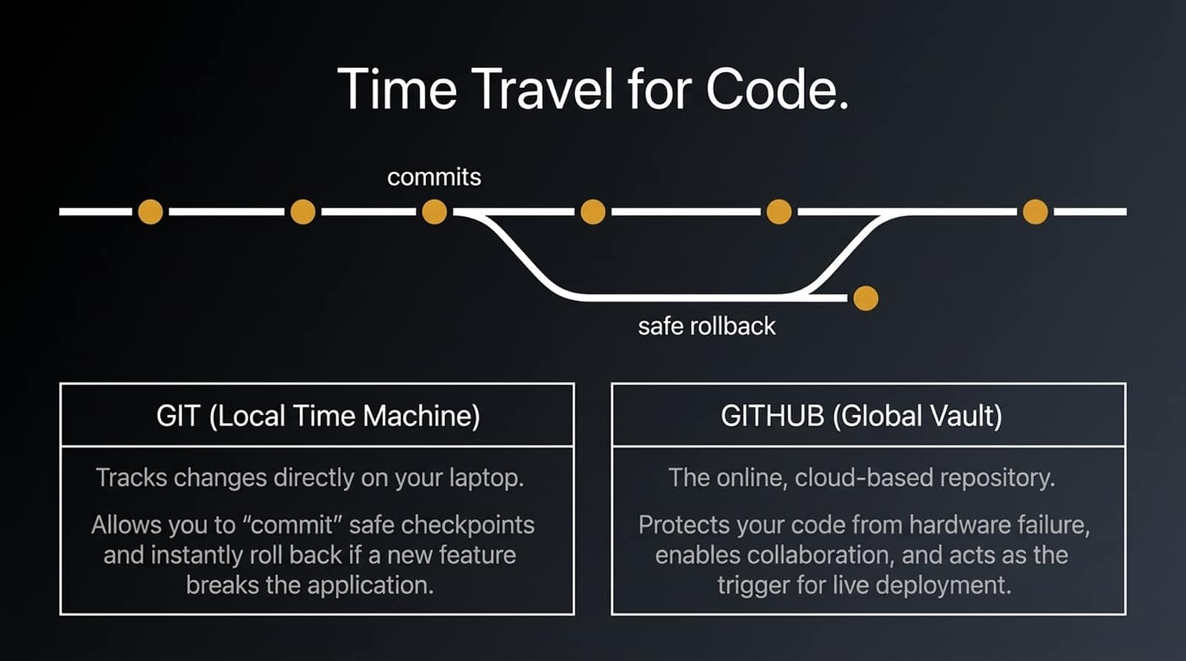
Notes:
Core Topic: Version Control, Local Commits, and Global Remote Vaults
When building with AI, your application will break often. That’s why we use version control—our time machine for code:
Git (Local Time Machine): Tracks changes directly on your laptop. It allows you to 'commit' safe checkpoints and instantly roll back if a newly prompted AI feature breaks your app.
GitHub (Global Vault): The online cloud-based repository. It protects your code from hardware failure, enables backup, and acts as the secure trigger for live production deployments.

Slide 8
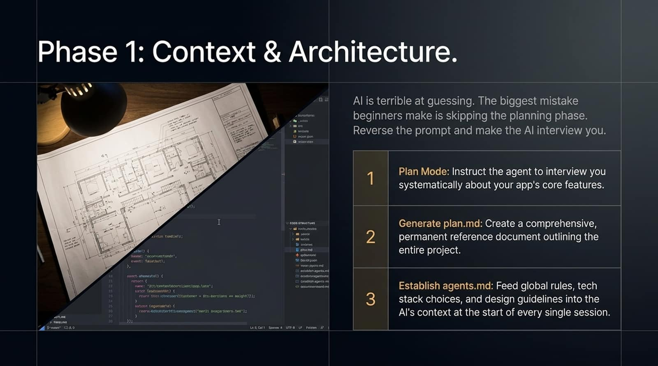
Notes:
Core Topic: Planning Mode, plan.md, and agents.md
Now let's walk through the 6-phase Vibe Coding Playbook. Phase 1 is Context & Architecture.
AI is terrible at guessing. The biggest mistake beginners make is skipping planning and jumping straight into coding. Reverse the prompt and make the AI interview you:
Plan Mode: Instruct the agent to interview you systematically about your app's core features.
Generate plan.md: Create a comprehensive, permanent reference document outlining the entire project scope.
Establish agents.md: Feed global rules, tech stack choices, and design guidelines into the AI's context at the start of every single session.

Slide 9
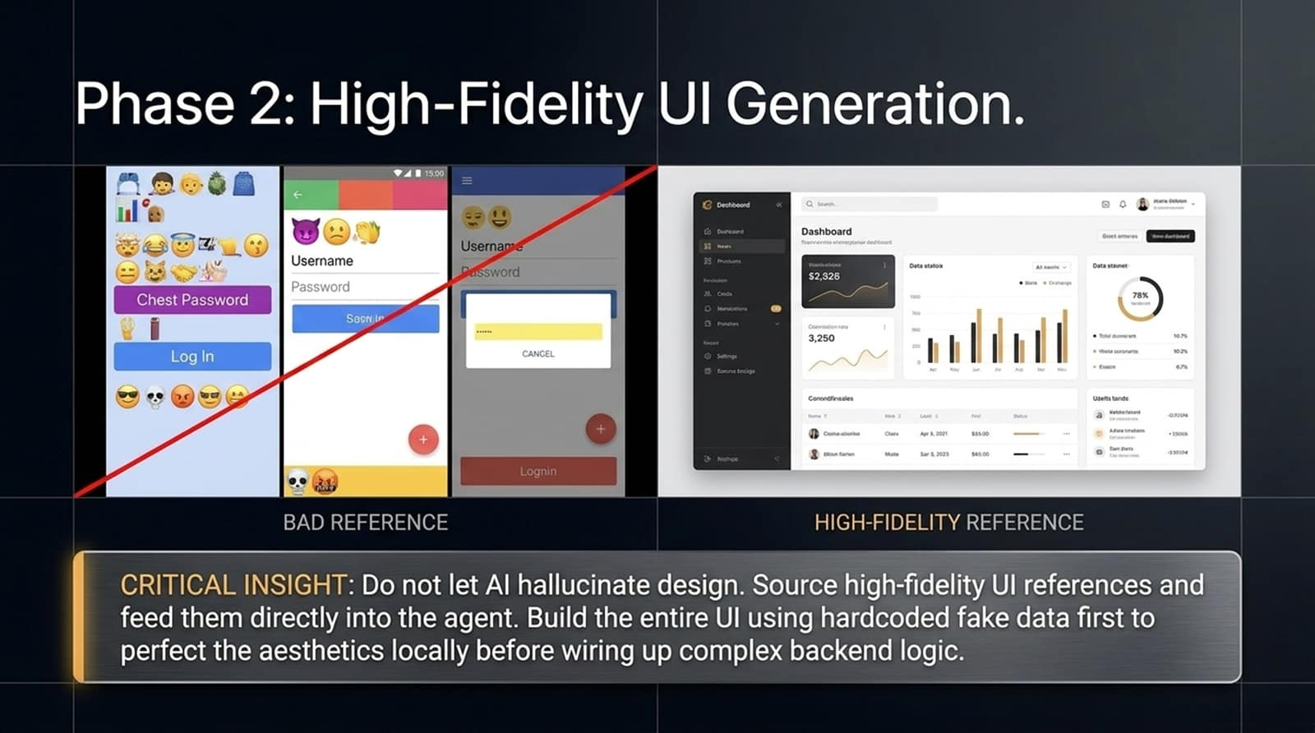
Notes:
Core Topic: Sourcing UI References and Prototyping with Hardcoded Mock Data
Phase 2 focuses on High-Fidelity UI Generation.
Look at the warning on this slide: Do not let AI hallucinate raw design, or you'll end up with generic, ugly interfaces (like the bad reference on the left). Instead, source professional UI references—like screenshots from Pinterest or top-tier SaaS dashboards—and feed them directly into your agent.
Critical Insight: Build the entire user interface using hardcoded fake data first. Perfect your aesthetics and user experience locally before wiring up complex backend databases and payment APIs.

Slide 10
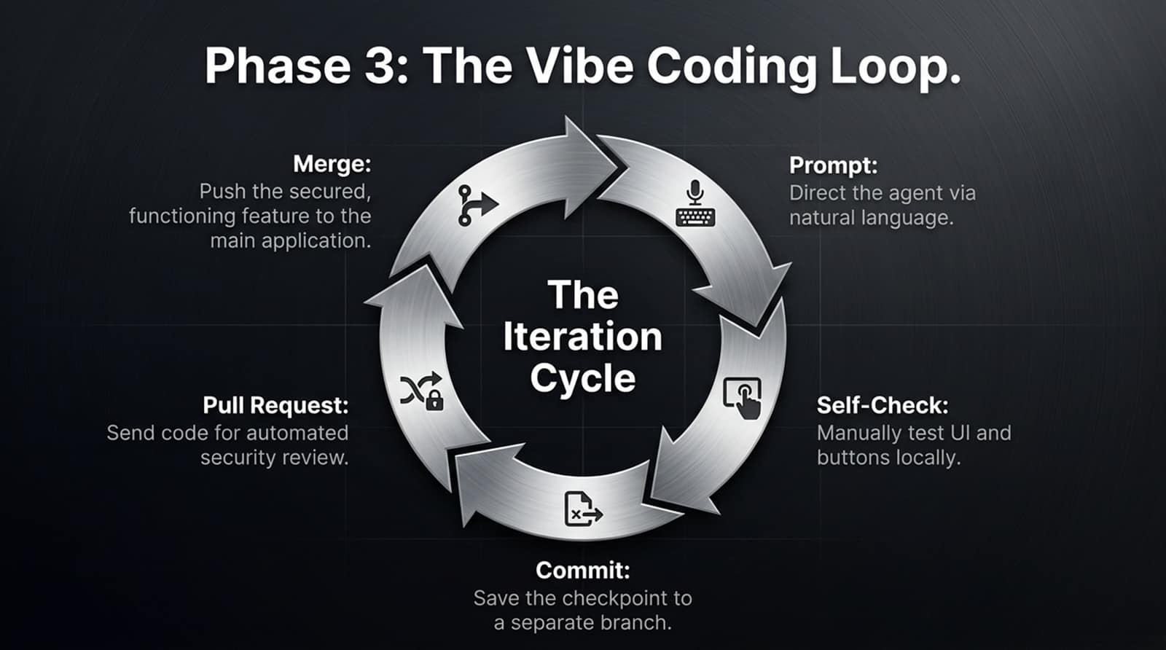
Notes:
Core Topic: The Iteration Cycle: Prompt, Test, Commit, PR, Merge
Phase 3 is the beating heart of our workflow: The Vibe Coding Loop.
Follow this disciplined iteration cycle for every single feature:
Prompt: Direct the agent via natural language for a specific feature.
Self-Check: Manually test the UI, buttons, and responsiveness locally.
Commit: Save the working checkpoint to a separate branch.
Pull Request: Send code for automated security review.
Merge: Push the secured, functioning feature into the main application.

Slide 11
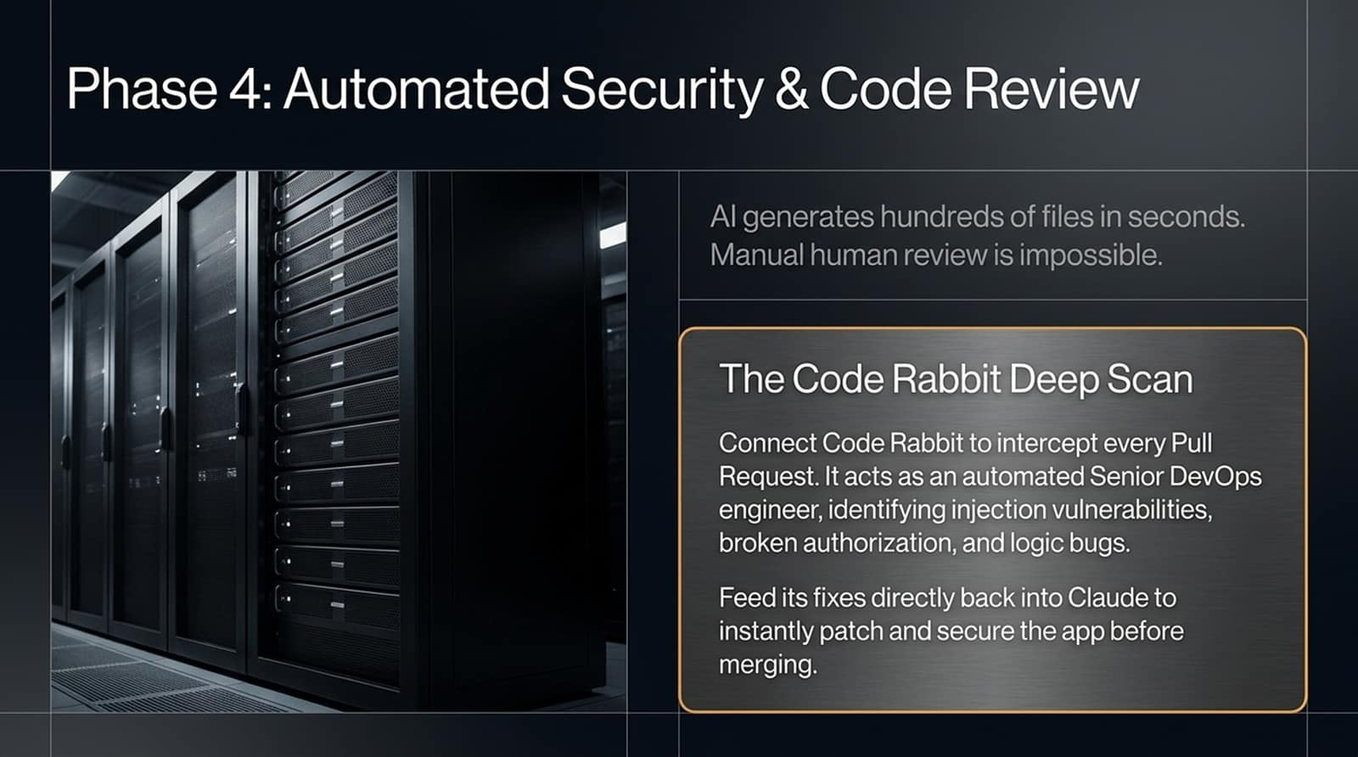
Notes:
Core Topic: CodeRabbit Deep Scans and Intercepting Vulnerabilities
Phase 4 addresses Automated Security & Code Review.
When you vibe code, AI can generate hundreds of files in seconds, making manual human code review virtually impossible. That's why we deploy CodeRabbit:
CodeRabbit intercepts every Pull Request on GitHub.
It acts as an automated Senior DevOps engineer, identifying injection vulnerabilities, broken user authorizations, and silent logic bugs.
Feed its security fixes directly back into your AI coding assistant to instantly patch and secure the app before merging.

Slide 12
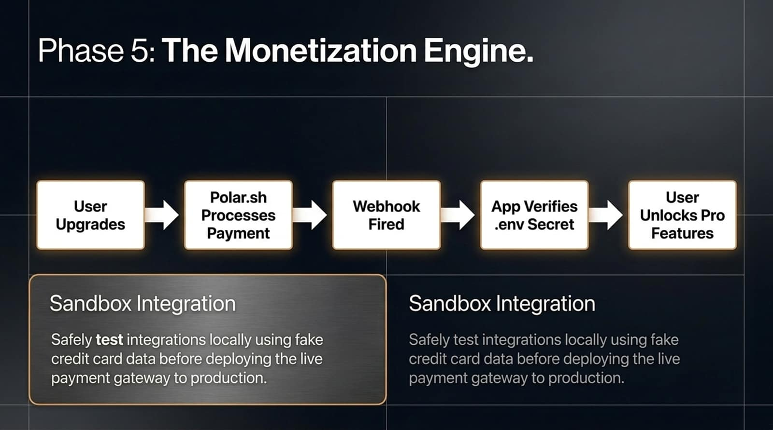
Notes:
Core Topic: Polar.sh Integration, Webhooks, and Sandbox Testing
Phase 5 is where your hobby turns into a business: The Monetization Engine.
Let's trace the payment flow:
User clicks 'Upgrade' on your app.
Polar.sh processes the payment securely.
A Webhook fires instantly back to your server.
Your app verifies the environment secret and unlocks pro features in the database.
Always use sandbox mode to test credit card transactions locally with fake test data before deploying your live payment gateway to production.

Slide 13
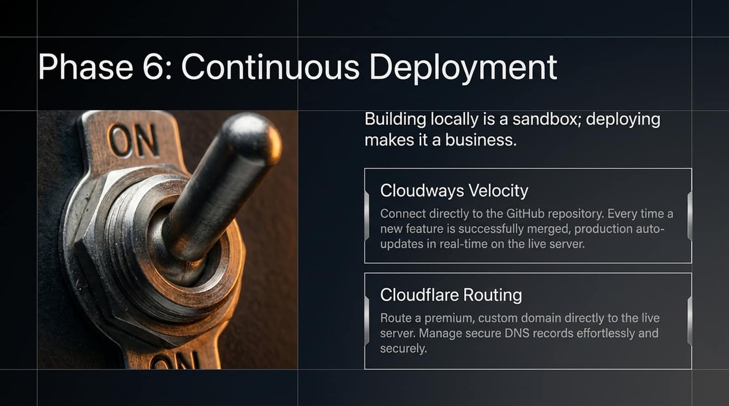
Notes:
Core Topic: Cloudways Velocity and Cloudflare Custom Domain Routing
Phase 6 brings us to Continuous Deployment. Building locally is just a sandbox; deploying makes it a real business.
Cloudways Velocity: Connects directly to your GitHub repository. Every time a new feature branch is successfully merged, production auto-updates in real-time on your live server.
Cloudflare Routing: Routes a premium, custom domain directly to your live server while managing secure DNS records effortlessly.

Slide 14
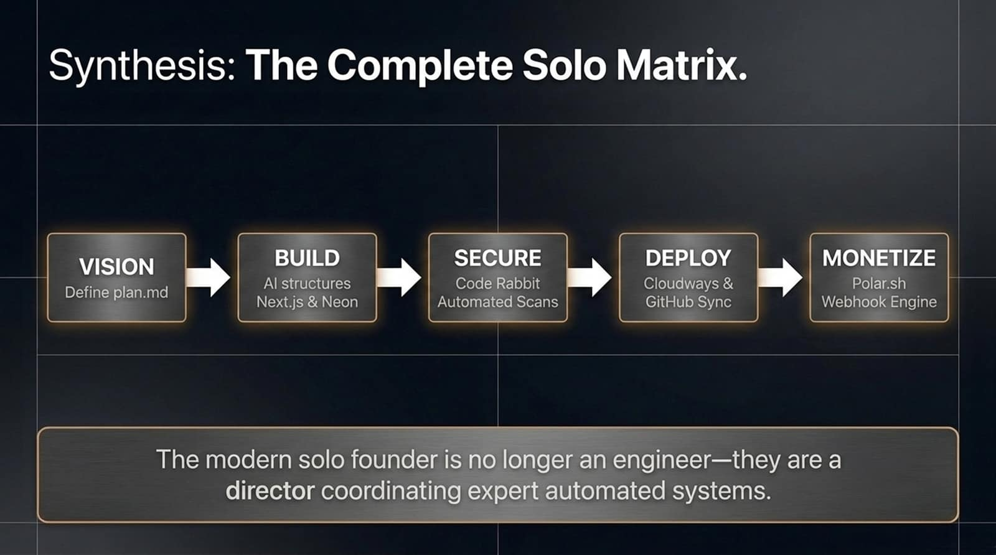
Notes:
Core Topic: Summary of the 5-Step Solo Founder Pipeline
Let's synthesize the complete solo matrix on this slide:
Vision: Define your scope in plan.md.
Build: Let AI structure your Next.js and Postgres database.
Secure: Run CodeRabbit automated vulnerability scans.
Deploy: Sync live via Cloudways and GitHub.
Monetize: Power subscriptions with Polar.sh webhooks.
The Core Takeaway: The modern solo founder is no longer a syntax typist—they are a director coordinating expert automated systems.

Slide 15

Notes:
Core Topic: The New Barrier to Entry in Software Development
As we look at the concluding message on this slide, the barrier to building software has fundamentally transformed:
It is no longer about technical coding skill; it is about clarity of thought, product vision, and creative problem-solving. With the right workflow and AI tools, any idea can become a fully functional, revenue-generating product.

Slide 16
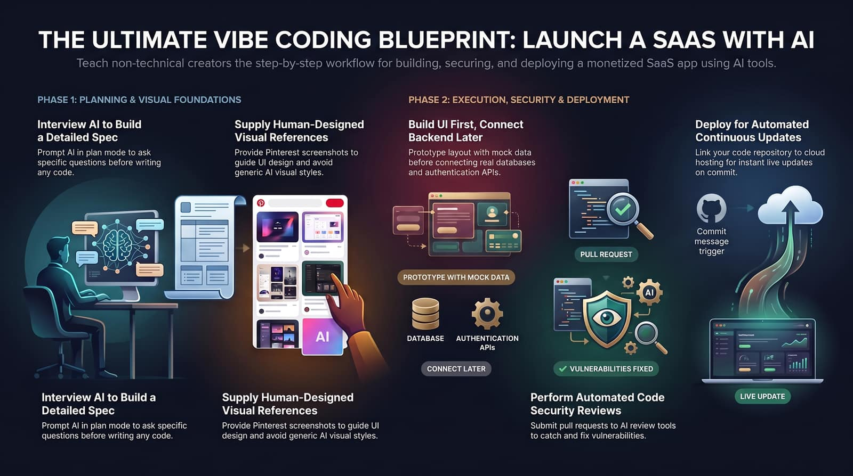
Notes:
Core Topic: Comprehensive Visual Recap of the Launch Workflow
To wrap up, this final blueprint encapsulates our entire journey: interview AI to build specs, supply human UI references, execute frontend prototyping before database wiring, run automated code reviews, and deploy continuously for live updates.
Thank you for joining today! Go build your SaaS.

